Slide 1
Math 152 – Lesson 3
Lesson | Topic | Reading | Homework
M2 | Areas & Distances | 5.1 | 2,13
M3 | The Definite Integral | 5.2 | 5,8
M4 | Approximate Integration | 7.7 | 2,11
Admin
25 Aug | Derivative Review (WeBWorK)
27 Aug | FSQ#1/FSPA #1 (WeBWorK)
27 Aug | HW Set #1 (L1 - L5)

Slide 2
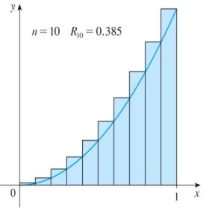




Definition of Definite Integral
The area beneath a curve can be approximated to within any desired degree of accuracy by a Riemann sum.
Suppose $f$ is continuous for $a≤t≤b$. The deﬁnite integral of $f$ from $a$ to $b$ is written as
The definite integral is the limit of the left-hand or right-hand sums with $n$ subdivisions of $a≤t≤b$ as $n$ goes to infinity.
Differential
$$\int_{a}^{b}{f\left(x\right)dx}$$
$$=\lim_{n→∞}{\sum_{i=1}^{n}{f(x{}_{i}^{∗} )∆x}}$$
Limits of Integration
Integrand

Slide 3
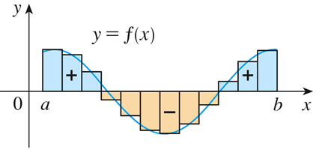
Definite Integral - Riemann Sums
If f takes on both positive and negative values, as in the Figure, then the Riemann sum is the sum of the areas of the rectangles that lie above the x-axis and the negatives of the areas of the rectangles that lie below the x-axis (the areas of the blue rectangles minus the areas of the gold rectangles).
A definite integral can be interpreted as a net area, that is, a difference of areas.
Notes:
When we take the limit of such Riemann sums, we get the situation illustrated.
A definite integral can be interpreted as a net area, that is, a difference of areas where A₁ is the area of the region above the x-axis and below the graph of f, and A₂ is the area of the region below the x-axis and above the graph of f.

Slide 4
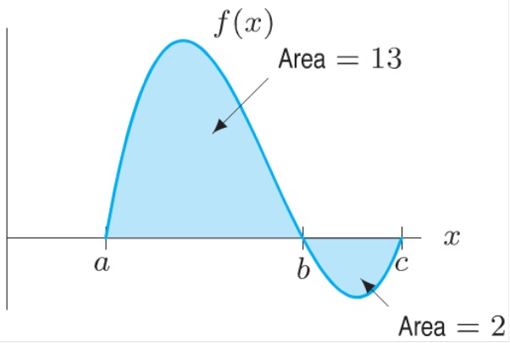

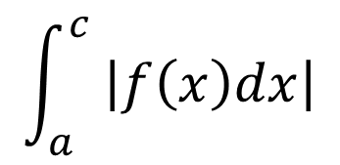


Definite Integral
A definite integral can be interpreted as a net area or the difference of areas
Calculate the following definite integrals:
$$\int_{a}^{b}{f\left(x\right)dx}$$
$$\int_{a}^{c}{f\left(x\right)dx}$$
$$\int_{b}^{c}{f\left(x\right)dx}$$
$$\int_{a}^{c}{ \left|f\left(x\right)dx\right|}$$
Notes:
Try these cold before next slide

Slide 5
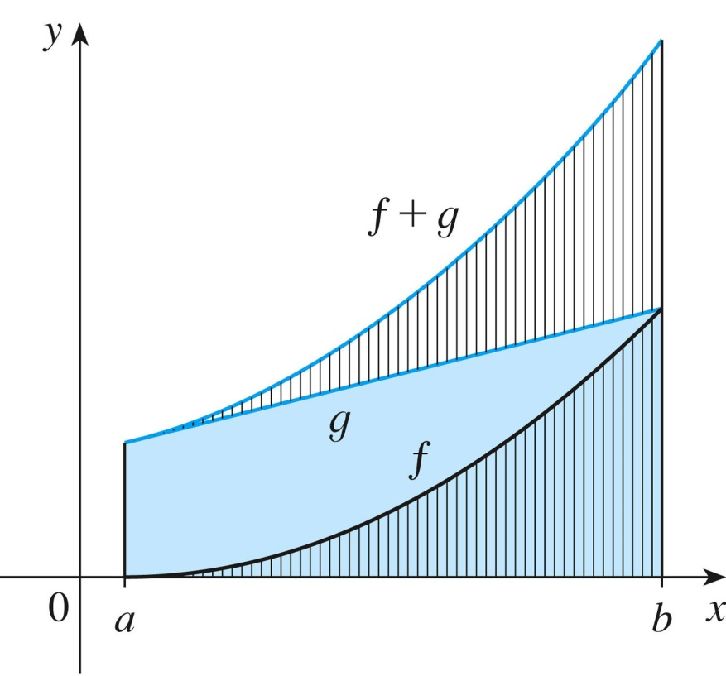
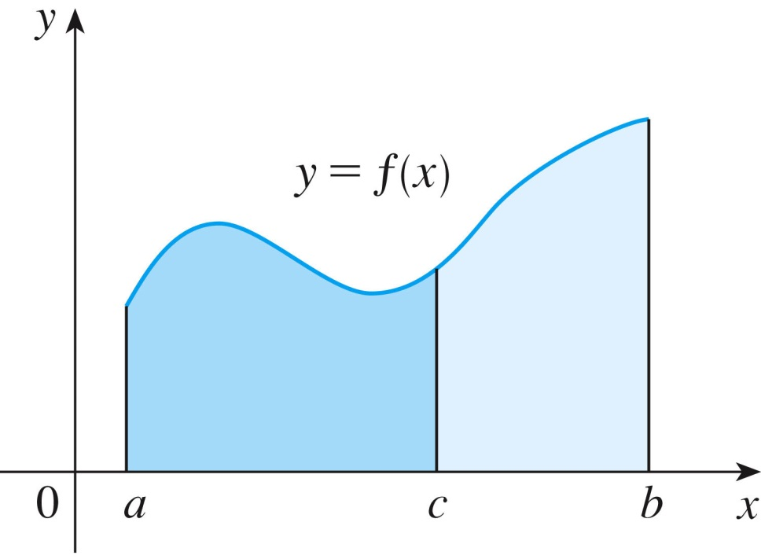
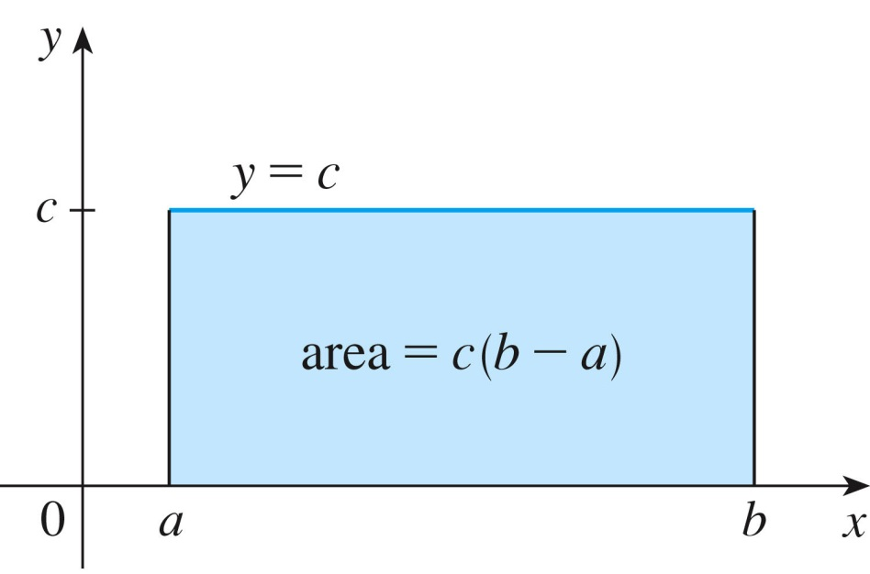
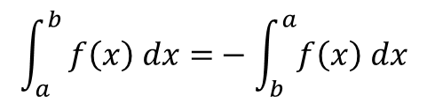
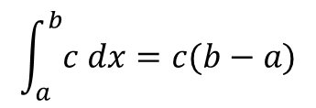
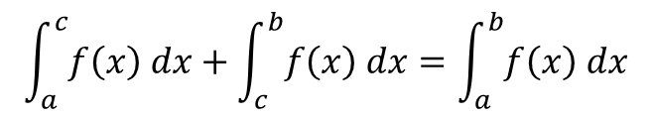
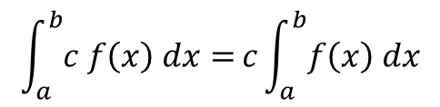
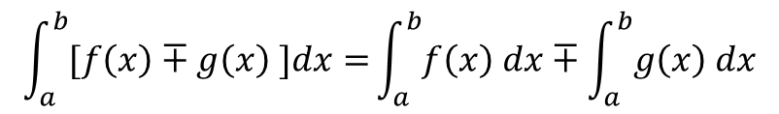
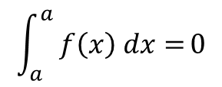
Integral Properties
$$\int_{a}^{b}{[f\left(x\right)∓g\left(x\right) ]dx=}\int_{a}^{b}{f\left(x\right) dx}∓\int_{a}^{b}{g\left(x\right) dx}$$
$$\int_{a}^{b}{c f\left(x\right) dx=}c\int_{a}^{b}{f\left(x\right) dx}$$
$$\int_{a}^{b}{c dx=c(b−a)}$$
$$\int_{a}^{b}{ f\left(x\right) dx=}−\int_{b}^{a}{f\left(x\right) dx}$$
$$\int_{a}^{a}{ f\left(x\right) dx=}0$$
$$\int_{a}^{c}{f\left(x\right) dx}+\int_{c}^{b}{f\left(x\right) dx}=\int_{a}^{b}{f\left(x\right) dx}$$

Slide 6
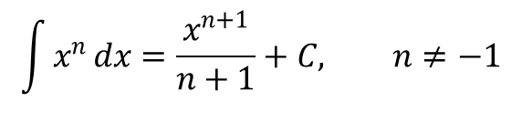
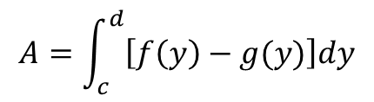
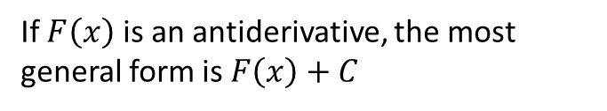
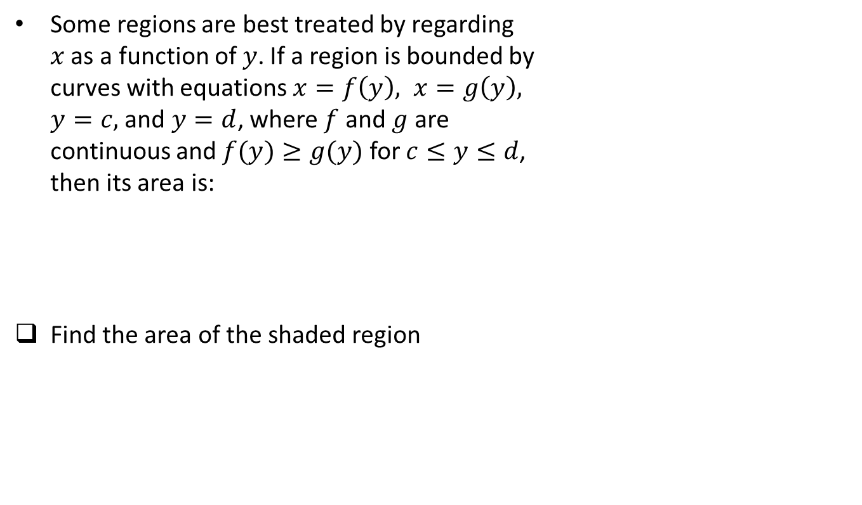
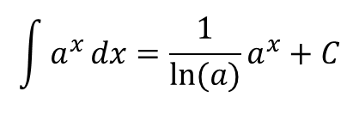

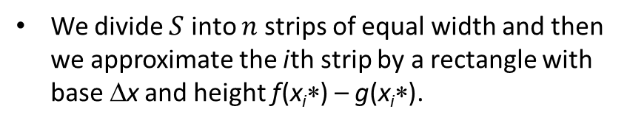
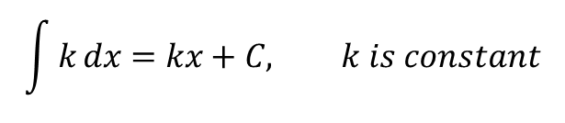
Common Antiderivatives
If $F^{′}\left(x\right)=f\left(x\right)$ then we say that $F$ is the antiderivative of $f$
$$\int{k}dx=kx+C, k is constant$$
$$\int{x^{n}}dx=\frac{x^{n+1}}{n+1}+C, n≠−1$$
$$\int{\frac{1}{x}}dx=\ln\left(\left|x\right|\right)+C$$
$$\int{a^{x}}dx={\frac{1}{\ln{(a)}}a}^{x}+C$$
$$\int{e^{x}}dx=e^{x}+C$$
$$\int{\cos\left(x\right)}dx=\sin\left(x\right)+C$$
$$\int{\sin\left(x\right)}dx=−\cos\left(x\right)+C$$
If $F\left(x\right)$ is an antiderivative, the most general form is $F\left(x\right)+C$
Notes:
Work problem 65: Stone dropped from CN Tower at 450m

Slide 7

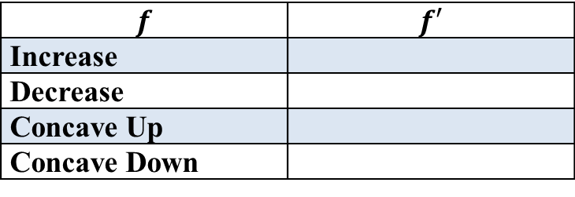
Graphing Antiderivatives
$$x$$ | $$f(x)$$ | $$CP,IP,$$ $$etc$$
0 | 2
1
2
3
4
5
$$f′(x)$$
Area = 2
Area = 4/3
Area = 4/3
$$f$$ | $$f′$$
Increase
Decrease
Concave Up
Concave Down
Notes:
0
2
NA
1
$3\frac{1}{3}$
Max
2
$2\frac{2}{3}$
IP (DU)
3
2
Min
4
3
IP(UD)
5
4
Max

Slide 8
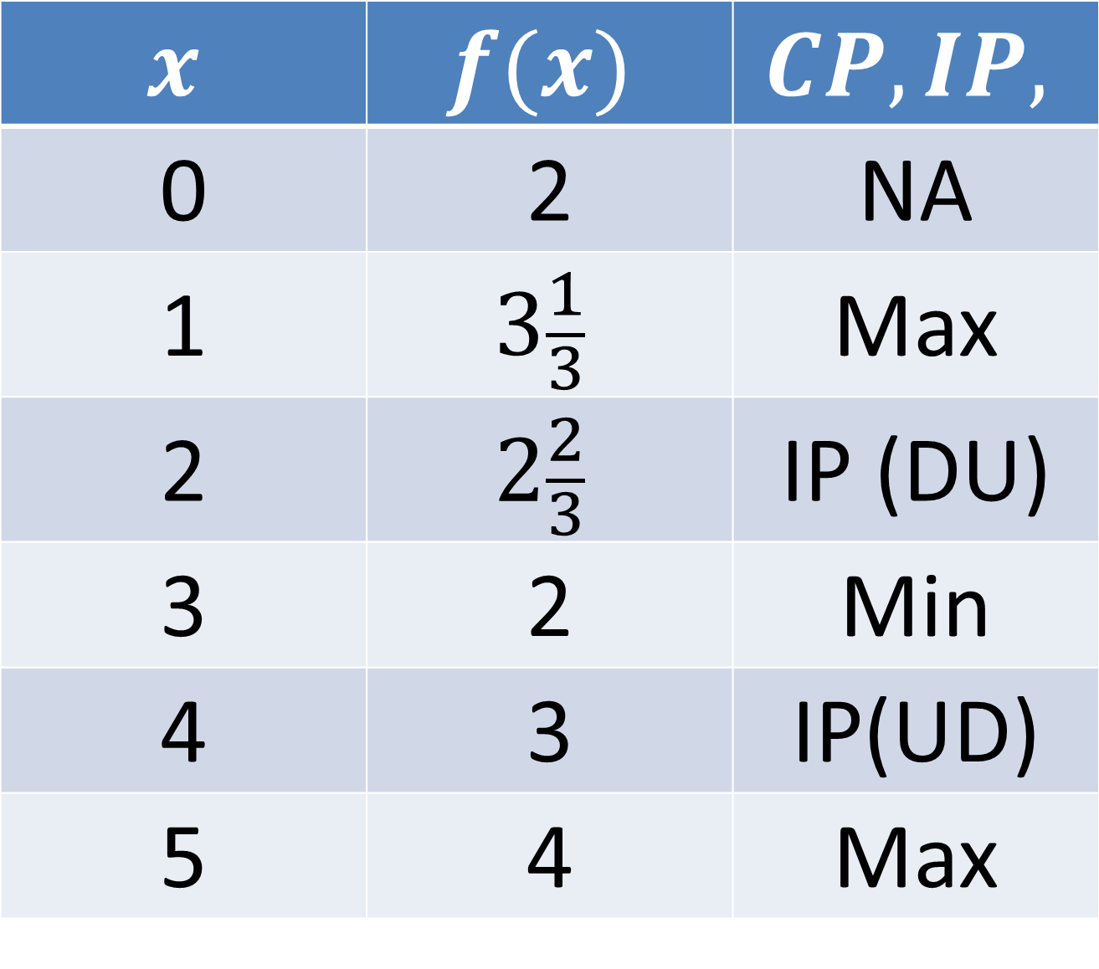
$$x$$ | $$f(x)$$ | $$CP,IP,$$
0 | 2 | NA
1 | $$3\frac{1}{3}$$ | Max
2 | $$2\frac{2}{3}$$ | IP (DU)
3 | 2 | Min
4 | 3 | IP(UD)
5 | 4 | Max

Slide 9
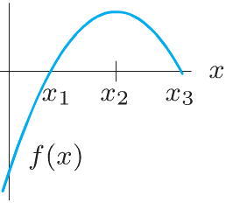
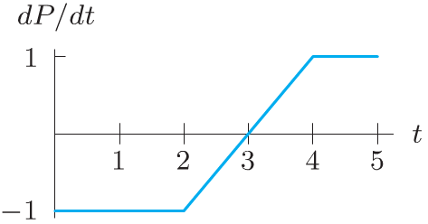
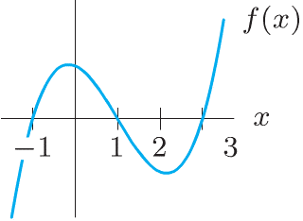
Board Work
Use Figure 1 and the fact that $P=2$ when $t=0$ to ﬁnd values of $P$ when $t=1, 2, 3, 4$ and $5$.
Given Figure 2, sketch two functions $F$ with $F^{′}\left(x\right)=f(x)$. In one, let $F(0)=0$; in the other, let $F(0)=1$. Mark $x_{1}, x_{2},$ and $x_{3}$ on the $x$-axis of your graph. Identify local maxima, minima, and inﬂection points of $F(x)$.
A graph of $f$ is given. Let $F^{′}\left(x\right)=f(x)$.
(a) What are the critical points of $F(x)$?
(b) Which critical points are local maxima, which are local minima, and which are neither?
(c) Sketch a possible graph of $F(x)$.
Figure 1
Figure 2

Slide 10
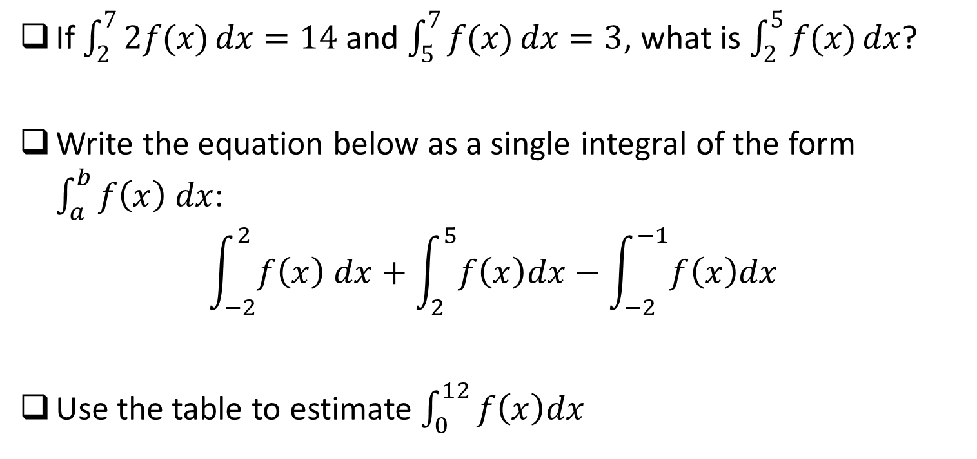
Seat Work
If $\int_{2}^{7}{2f(x)}dx=14$ and $\int_{5}^{7}{f(x)}dx=3$, what is $\int_{2}^{5}{f(x)}dx$?
Write the equation below as a single integral of the form $\int_{a}^{b}{f\left(x\right) dx}$:
$$\int_{−2}^{2}{f\left(x\right) dx}+\int_{2}^{5}{f\left(x\right)dx}−\int_{−2}^{−1}{f\left(x\right)dx}$$
Use the table to estimate $\int_{0}^{12}{f\left(x\right)dx}$
x | 0 | 3 | 6 | 9 | 12
f(x) | 32 | 22 | 15 | 11 | 9
Notes:
Ask about midpoint on second problem

